Slide 1
Probability and statistics 02-Basics
상명대학교 휴먼지능정보공학과
2022년 2학기

Slide 2
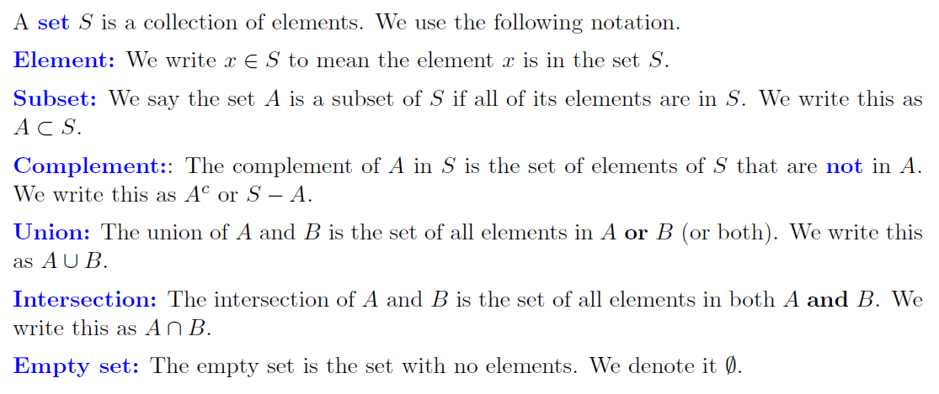
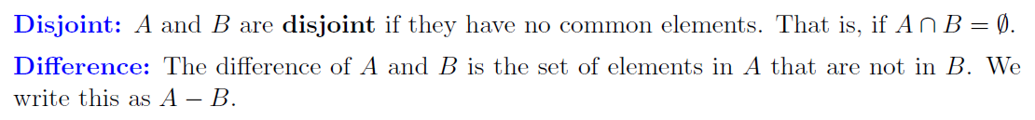
Terminologies

Slide 3
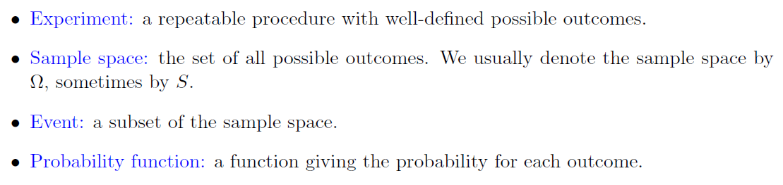
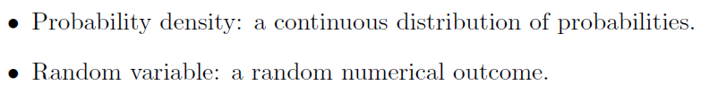
Terminologies
표본 공간
사건
확률 변수

Slide 4
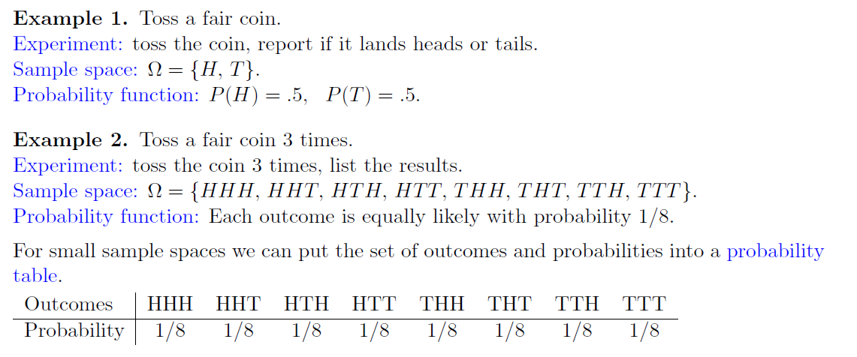
Examples

Slide 5
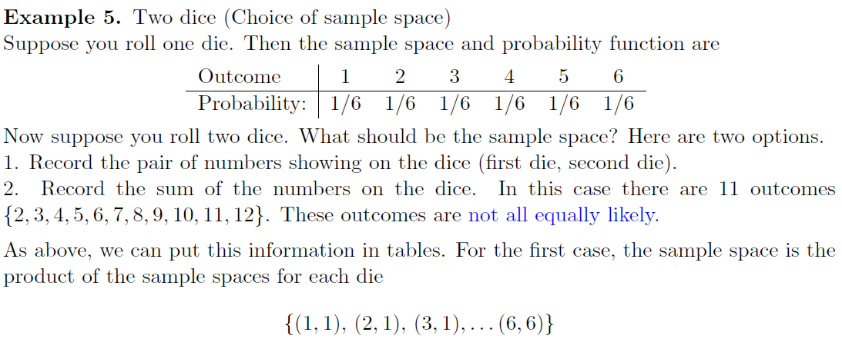
Examples (2/2)
The best choice of sample space depends on the context.

Slide 6
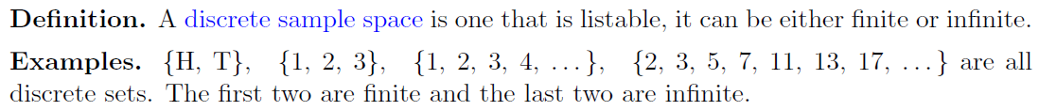
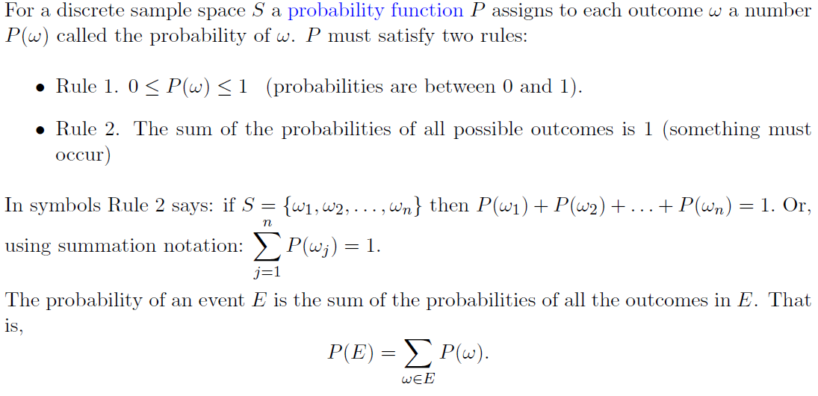
Probability function

Slide 7
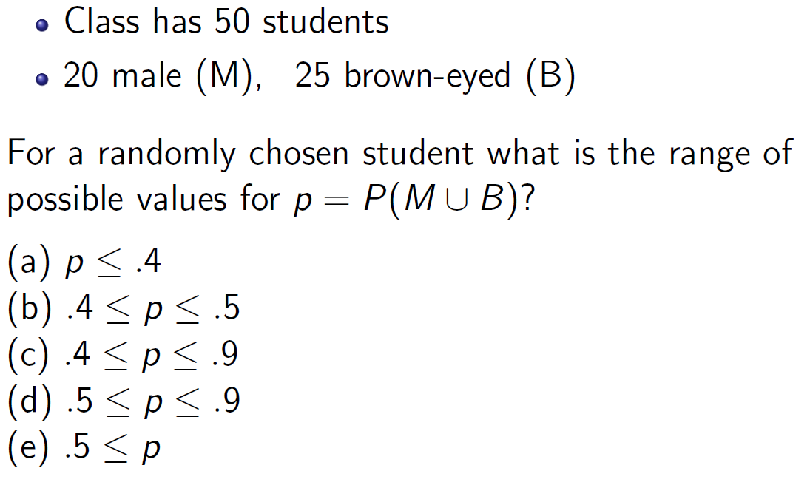
Question

Slide 8
Question 2
Experiment:
1. You should make 9 rolls of a 20-sided die.
2. Check if all rolls are distinct.
For this experiment, how would you define the sample space, number of outcomes in sample space, probability function, and event?
Compute the probability that some of the rolls show the same side.
Hint: Use a complement of an Event (E^{c}) ← What would be the event E?

Slide 9
Question 3
An unfair coin is flipped twice.
Bet whether the outcomes will be the same (HH, TT) or different (HT, TH).
Which should you choose?
1. Same 2. Different 3. Doesn’t matter
Question: Let p be the probability of heads and answer the question.

Slide 10
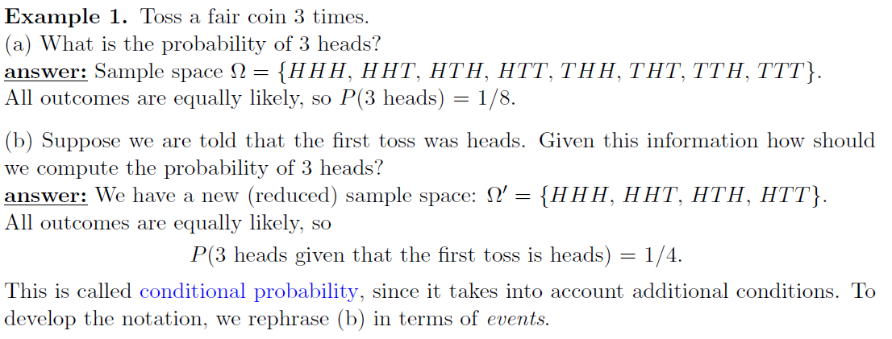
Conditional probability
Conditional probability answers the question ‘how does the probability of an event change if we have extra information’.

Slide 11
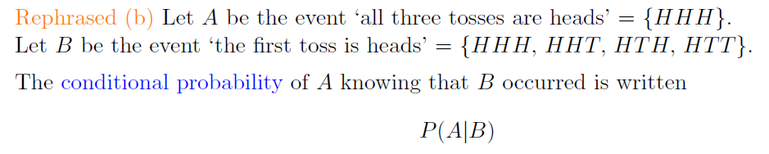
Conditional probability
This is read as ‘the conditional probability of A given B’
or ‘the probability of A conditioned on B’
or simply ‘the probability of A given B’.

Slide 12
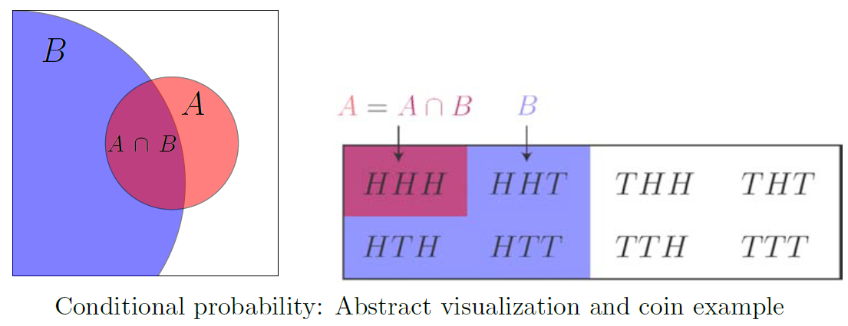
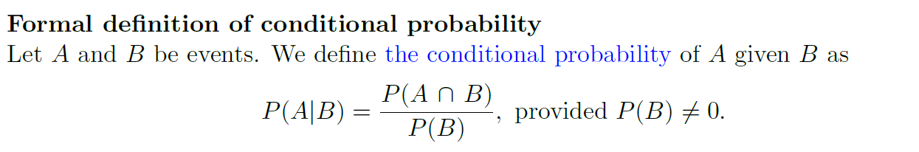
Conditional probability

Slide 13
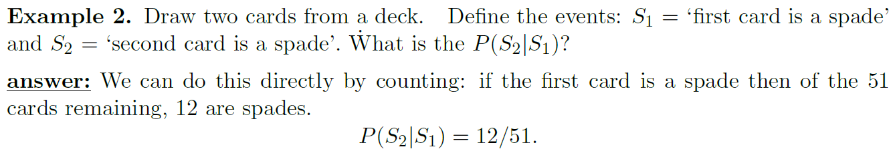
Question
Q: Recalculate the example using the conditional probability equation in the previous page.
What is P(S1)?
What is P(S2 ∩ S1)?
What is P(S2|S1)?
What is P(S2)?

Slide 14
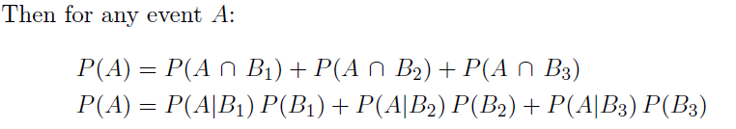
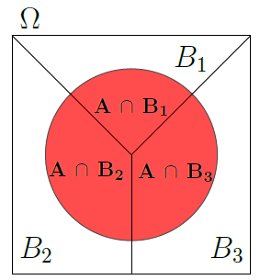
Law of Total Probability
Suppose the sample space Ω is divided into 3 disjoint events B1, B2, B3.

Slide 15
Question
An urn contains 5 red balls and 2 green balls. Two balls are drawn one after the other. What is the probability that the second ball is red?
Hint:
Let R1 be the event ‘the first ball is red’, G1 = ‘first ball is green’, R2 = ‘second ball is red’, G2 = ‘second ball is green’. We are asked to find P(R2).
Answer: P(R2)=5/7.
Question: Find P(R2) with the law of total probability.

Slide 16
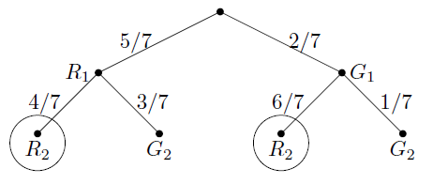
Question 2
An urn contains 5 red balls and 2 green balls.
A ball is drawn. If it’s green a red ball is added to the urn and if it’s red a green ball is added to the urn. (The original ball is not returned to the urn.)
Then a second ball is drawn.
What is the probability the second ball is red?
What is the probability the first ball was red given the second ball was red?
Answer:
The sample space = {rr, rg, gr, gg}.
R1 is the event ‘the first ball is red’, etc.
Let’s use the law of total probability.
P(R2) = P(R2|R1)P(R1)+P(R2|G1)P(G1) = 4/7 * 5/7 + 6/7 * 2/7 =
P(R2) = 32/49
Bayes’ rule: P(R1|R2) = P(R1∩R2)/P(R2) = (20/49)/(32/49) = 20/32

Slide 17
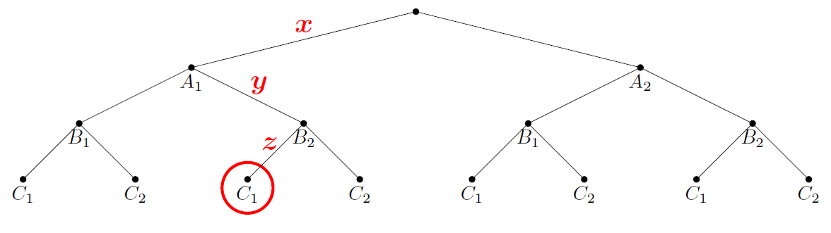
Question 3
x= ? ; y= ? ; z= ? ; the circle = ?
x = P(A1); y = P(B2|A1); z = P(C1|A1∩B2)
The circle is the event that A1∩B2∩C1

Slide 18

Monty Hall
One door hides a car, two hide goats.
The contestant chooses any door.
Monty always opens a different door with a goat. (He can do this because he knows where the car is.)
The contestant is then allowed to switch doors if she wants.
What is the best strategy for winning a car?
Switch (b) Don’t switch (c) It doesn’t matter
Question: Organize the Monty Hall problem into a tree and compute the probability of winning if you always switch.
Hint: Break the game into a sequence of actions.

